Slide 1
Inter-Integrated
Circuit (I2C) Protocol
K.LOKESH
Chipweave Technologies Private Limited

Slide 2
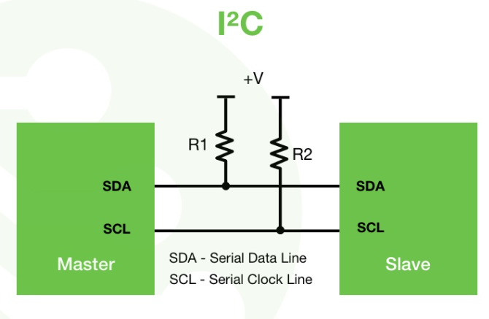
Introduction to the I2C Protocol
I²C stands for Inter-Integrated Circuit
It is a serial and synchronous communication protocol
I2C is a serial communication protocol, so data is transferred bit by bit along a single wire (the SDA line).
I2C only uses two wires to transmit data between devices:
    SDA (Serial Data) – The line for the master and slave to send and receive data.
    SCL (Serial Clock) – The line that carries the clock signal.
Widely used for on-board communication between ICs.

Slide 3
Introduction to the I2C Protocol
Multiple devices can communicate using the same two I²C lines (SDA and SCL).
Supports bidirectional, half-duplex communication.
Both master and slave devices can send and receive data.
Can operate at different speed modes:
    Up to 100 kbit/s in Standard Mode
    Up to 400 kbit/s in Fast Mode
    Up to 1 Mbit/s in Fast-mode Plus
    Up to 3.4 Mbit/s in High-speed Mode
    Up to 5 Mbit/s in Ultra-Fast Mode

Slide 4
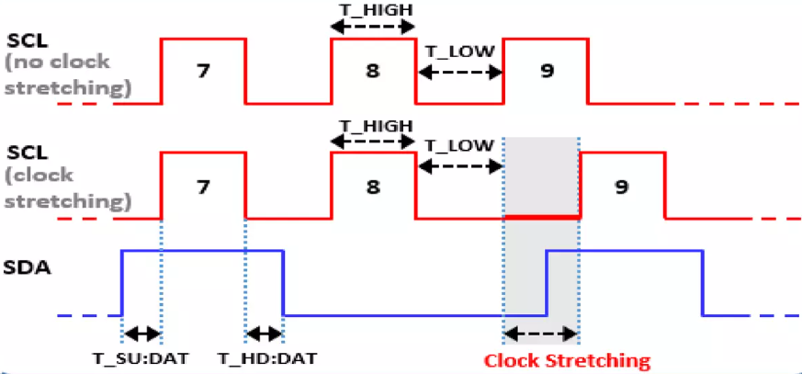
Advanced I2C Features
Clock Stretching
    Clock stretching allows slave devices to slow down the clock signal when they need more time to process data, providing a mechanism for better control over data flow and ensuring reliable communication.
.

Slide 5
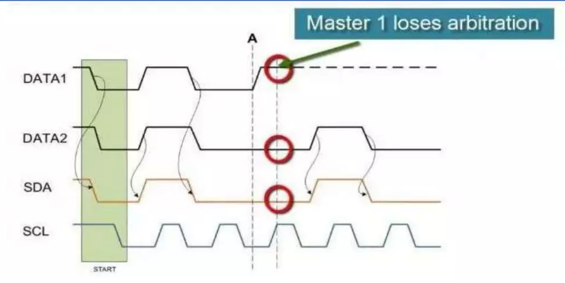
Advanced I2C Features
Multi-Master Arbitration
    I2C supports multi-master configurations, allowing multiple master devices to share the bus. Collision detection and resolution mechanisms ensure that data integrity is maintained during simultaneous access attempts.

Slide 6
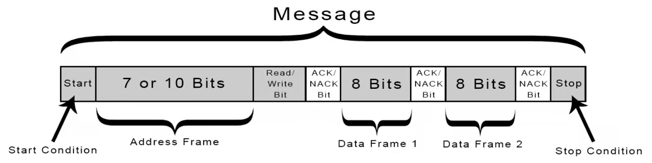
How I2C Work
With I2C, data is transferred in messages. Messages are broken up into frames of data. Each message has an address frame that contains the binary address of the slave, and one or more data frames that contain the data being transmitted.
The message also includes start and stop conditions, read/write bits, and ACK/NACK bits between each data frame:

Slide 7
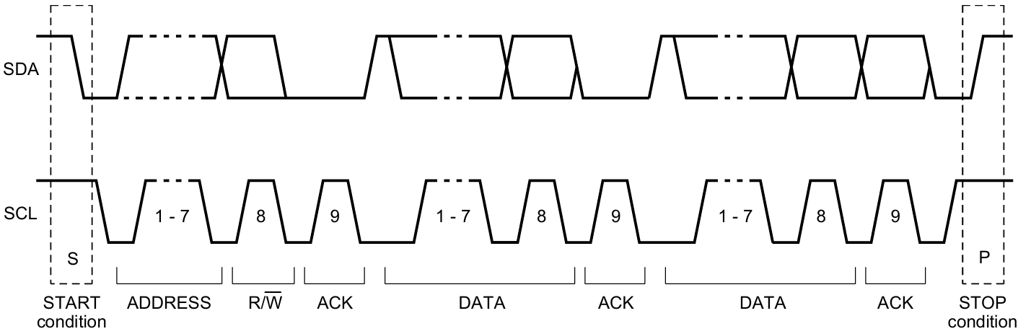
Data Frame Overview of I²C Protocol
Start Condition: SDA line switches from a high voltage to low voltage level before the SCL line switches from high to low.
Stop Condition: SDA line switches from a low voltage to high voltage level after the SCL line switches from low to high.
A START and STOP condition are always asserted by the master.

Slide 8
Data Frame Overview of I²C Protocol
Address Frame:
    A 7-bit or 10-bit unique sequence used to identify the slave device when the master wants to communicate with it.
Read/Write Bit
    This bit specifies the direction of data transfer. If the master device/IC need to send data to a slave device, this bit is set to ‘0’. If the master IC needs to receive data from the slave device, it is set to ‘1’.
ACK/NACK Bit
    It stands for Acknowledged/Not-Acknowledged bit. If the physical address of any slave device coincides with the address broadcasted by the master device.
    The value of this bit is set to ‘0’ by the slave device. Otherwise it remains at logic ‘1’ (default).
Data Block
    It comprises of 8 bits and they are set by the sender, with the data bits it needs to transfer to the receiver. This block is followed by an ACK/NACK bit and is set to ‘0’ by the receiver if it successfully receives data. Otherwise it stays at logic ‘1’.

Slide 9
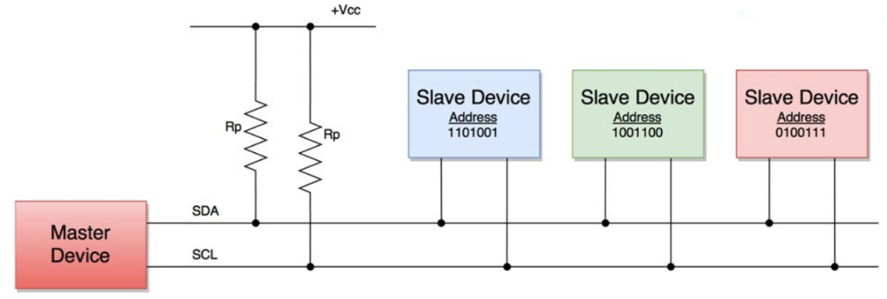
Steps of I2C Data Transmission
The master sends the start condition to every connected slave by switching the SDA line from a high voltage level to a low voltage level before switching the SCL line from high to low.
The master sends each slave the 7 or 10 bit address of the slave it wants to communicate with, along with the read/write bit:
Each slave compares the address sent from the master to its own address. If the address matches, the slave returns an ACK bit by pulling the SDA line low for one bit. If the address from the master does not match the slave’s own address, the slave leaves the SDA line high.

Slide 10
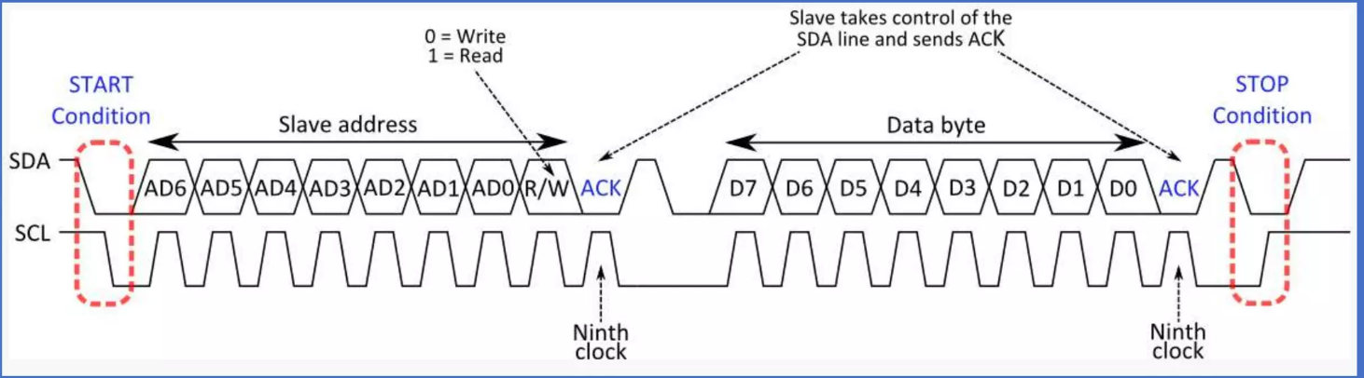
Data Frame Overview of I²C Protocol
4.The master sends or receives the data frame.
5. After each data frame has been transferred, the receiving device returns another ACK bit to the sender to acknowledge successful receipt of the frame.
6. To stop the data transmission, the master sends a stop condition to the slave by switching SCL high before switching SDA high:

Slide 11
Data Frame Overview of I²C Protocol
Advantages
Only uses two wires
Supports multiple masters and multiple slaves
ACK/NACK bit gives confirmation that each frame is transferred successfully
Hardware is less complicated than with UARTs
Well known and widely used protocol
Error Detection
Disadvantages
Slower data transfer rate than SPI
The size of the data frame is limited to 8 bits
More complicated hardware needed to implement than SPI

Slide 12
Thank You !

